Slide 1
Co-related queries
Use of Exists and Not Exists

Slide 2
Exists & Not Exists Operator
The EXISTS operator is used to test for the existence of any record in a subquery.
The EXISTS operator returns true if the subquery returns one or more records.
The NOT EXISTS operator returns true if the subquery returns no records at all.

Slide 3
Corelated query
A correlated subquery is a subquery that uses values from the outer query.
Show the detail of employees who is working on at least one project
SELECT * FROM EMPLOYEE WHERE ssn IN ( SELECT DISTINCT Essn FROM WORKS_ON); | SELECT * FROM EMPLOYEE WHERE EXISTS ( SELECT * FROM WORKS_ON WHERE WORKS_ON.Essn = EMPLOYEE.ssn );

Slide 4
Corelated query
Show employees who do not have any dependents.
SELECT * FROM EMPLOYEE WHERE ssn NOT IN ( SELCT DISTINCT Essn FROM DEPENDENT ); | SELECT * FROM EMPLOYEE WHERE NOT EXISTS ( SELECT * FROM DEPENDENT WHERE DEPENDENT. Essn =EMPLOYEE.ssn )

Slide 5
Example
Show the name of all customers who placed at least one order.
Can we do it by nesting?
Customer :
Order:
ID | Name | Address | Phone
ID | C_id | Delievery_Date | Status

Slide 6
Example
Show the name of all customers who placed at least one order.
Customer :
Order:
SELECT Name
FROM Customer WHERE EXISTS (SELECT * FROM Order WHERE Customer.ID = Order.C_id);
ID | Name | Address | Phone
ID | C_id | Delievery_Date | Status

Slide 7
Example
Show the name of all customers who has not placed any order.
Customer :
Order:
SELECT Name
FROM Customer WHERE NOT EXISTS (SELECT * FROM Order WHERE Customer.ID = Order.C_id);
ID | Name | Address | Phone
ID | C_id | Delievery_Date | Status

Slide 8
Try these with Corelated Method.
Show employee names who are managers and they have at least one dependent.
Show employee name who are managers but they do not have dependents.
Show project name on which Aliya is not working.
Show all dependent name of employees working in IT department.
Show employee names who work in research department.
Show project names in which an employee ‘John Smith’ works.
Show all project names which are controlled by a department in which ‘John Smith’ works.
Show employee names who has a supervisor with the same salary as themselves.
Show employee names who do not work on any project.
Show department names which are not controlling any project and has a location in Houston.

Slide 9
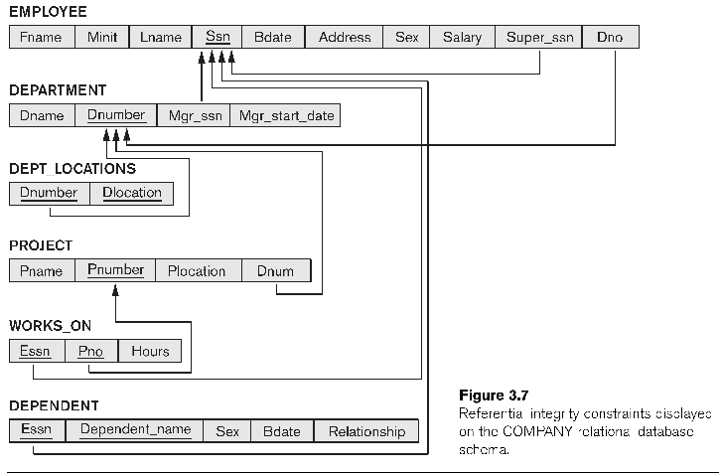
Query 1
Select the project names of projects that have employee with last name smith involved as manager or as a worker.

Slide 10
Query 1
Select the project names of projects that have employee with last name smith involved as manager or as a worker.
Step one: Break query into pieces.
Project number of all those project in which smith is involved as worker
Project number of all those projects in which smith is involved as manager

Slide 11
Query 1
Project number of all those project in which smith is involved as worker
Select wo.pno
From WORKS_ON AS wo INNER JOIN EMPLOYEE AS e ON e.ssn = wo.essn
WHERE e.Lname = 'smith';

Slide 12
Query 1
Project number of all those projects in which smith is involved as manager
SELECT p.Pnumber
FROM PROJECT AS p INNER JOIN DEPARTMENT AS d ON p.Dnum = d.Dnumber INNER JOIN EMPLYEE AS e ON d.Mgr_ssn = e.ssn
WHERE Lname = 'Smith'

Slide 13
Query 1
SELECT DISTINCT Pname
FROM Project
Where Pnumber IN (Select wo.pno
From WORKS_ON AS wo INNER JOIN EMPLOYEE AS e ON e.ssn = wo.essn
WHERE Lname = 'smith';
)
OR Pnumber IN (SELECT p.Pnumber
FROM PROJECT AS p INNER JOIN DEPARTMENT AS d ON p.Dnum = d.Dnumber INNER JOIN EMPLYEE AS e ON d.Mgr_ssn = e.ssn
WHERE Lname = 'Smith');

Slide 14
Query 2
Select Name of all the employees who work the same (project,hours) combination on some project as ‘John Smith’ whose ssn is ‘123456789’
Step 1: find project and hours of ssn ‘123456789’
Step 2: find ssn of all employees with same working hours and project number
Step 3: find name of those employees.

Slide 15
Query 2
find project and hours of ssn ‘123456789’
SELECT Essn From WORKS_ON WHERE (Pno, Hours) IN
(
SELECT Pno, Hours
FROM WORKS_ON
WHERE ESSN = '123456789');

Slide 16
Query 2
find ssn of all employees with same working hours and project number
SELECT Fname, Lname FROM EMPLOYEE WHERE ssn IN (
SELECT Essn
FROM WORKS_ON
WHERE (Pno, Hours) IN
(SELECT Pno, Hours
FROM WORKS_ON
WHERE ESSN = '123456789')
);

Slide 17
Query 2
Select Name of all the employees who work the same (project,hours) combination on some project as ‘John Smith’ whose ssn is ‘123456789’
SELECT Fname , Lname
FROM EMPLOYEE
WHERE ssn IN (
SELECT Essn
FROM WORKS_ON
WHERE (Pno, Hours) IN (SELECT Pno, Hours
FROM WORKS_ON
WHERE ESSN = '123456789'
));

Slide 18
Query 3
Show name of all those employees whose salary is greater than all employees of Dno = 5.
Step 1: salary of all employees of dno = 5.
Step 2: name of all employees with salary greater than all employees of dno = 5.

Slide 19
Query 3
Step 1: salary of all employees of dno = 5.
SELECT Fname , Lname FROM EMPLOYEE WHERE salary > ALL (
20000, 30000, 50000, 55000... );

Slide 20
Query 3
Step 2: name of all employees with salary greater than all employees of dno = 5.
SELECT Fname , Lname
FROM Employee
WHERE salary > ALL (SELECT salary
FROM EMPLOYEE
WHERE Dno = 5);

